Slide 1
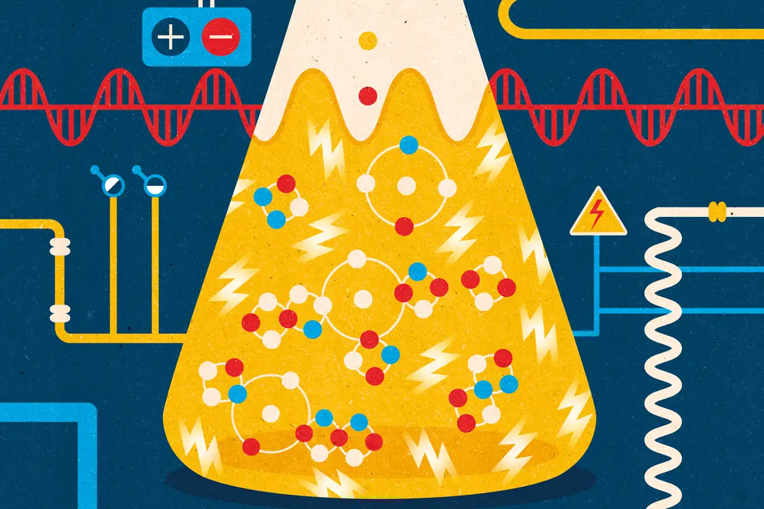
Direct redox reactions:
Spontaneous or Non-spontaneous?

Slide 2
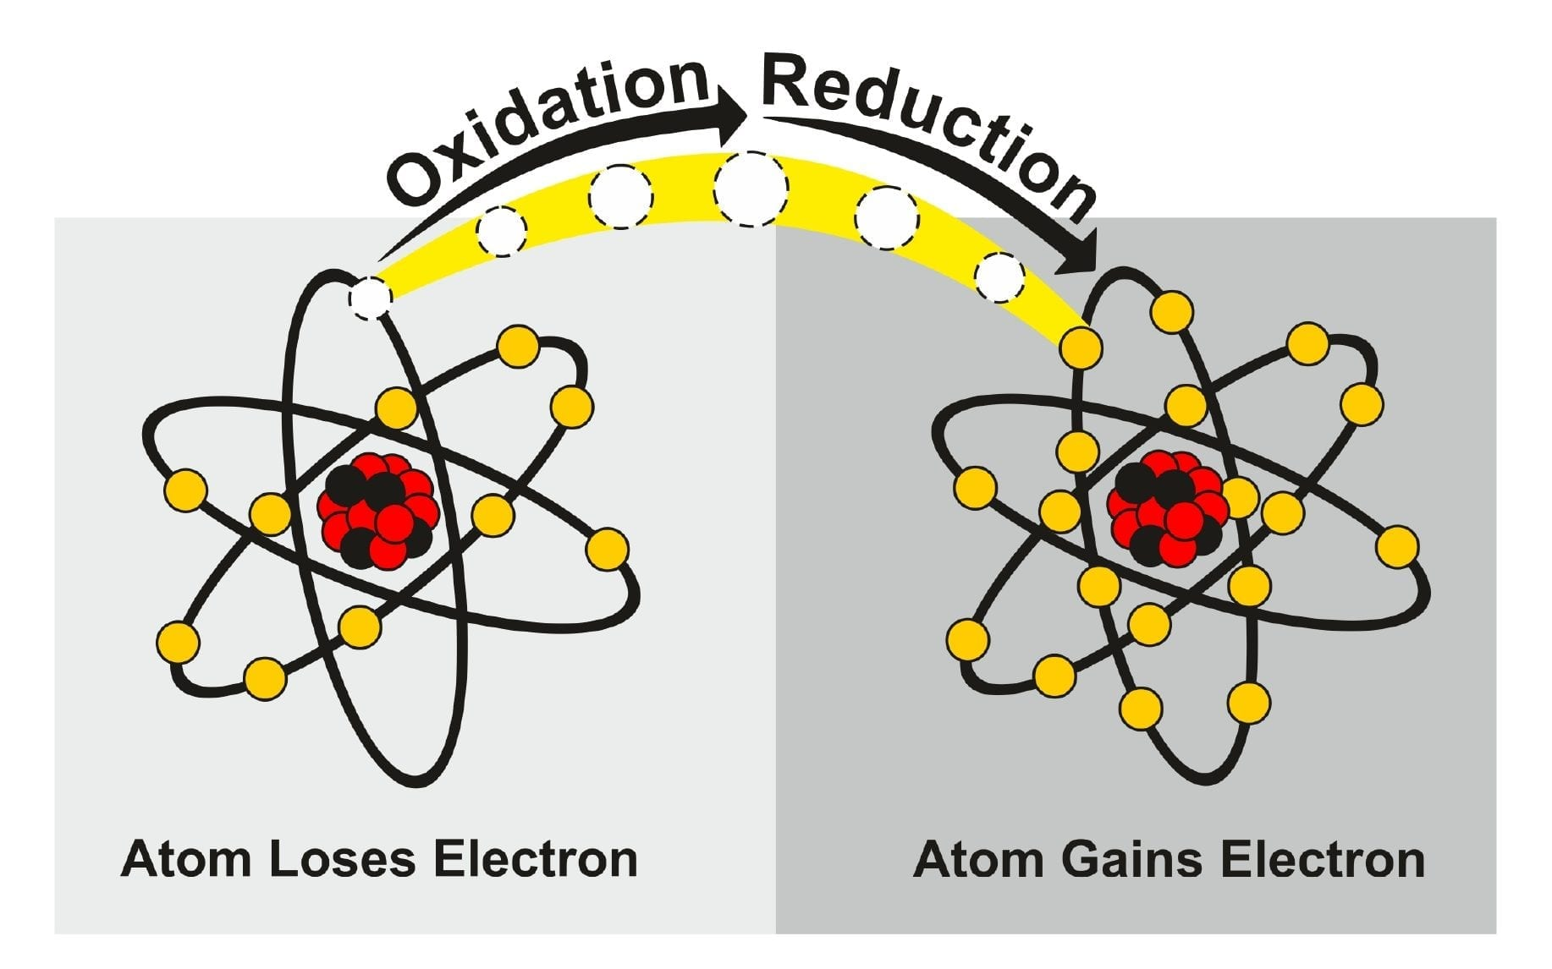
Overview
Review
Metal displacement reactions – spontaneous vs non-spontaneous
Standard Reduction Potential (SRP) table
Using SRP table to predict reaction outcomes

Slide 3
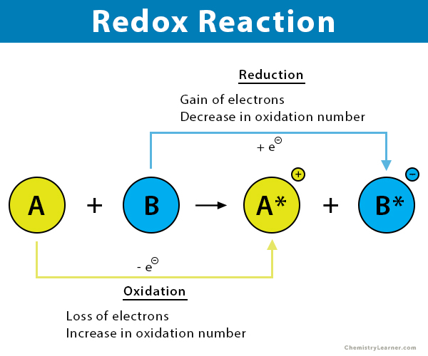
Review
Redox reaction must occur in pairs – reduction and oxidation
We can write half-equations where something gains electrons, and something loses electrons

Slide 4
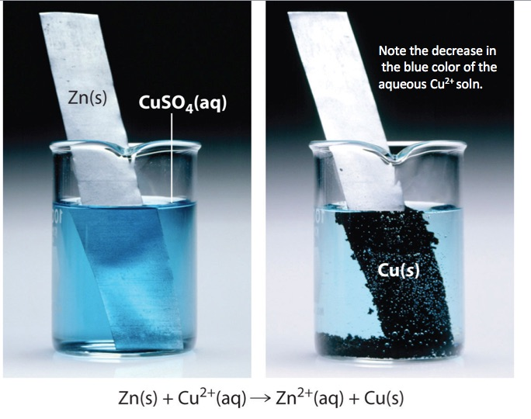
Metal displacement reaction
Zinc metal (Zn) is placed in a beaker with copper sulfate (CuSO₄)
ie a metal plus metal cation
Black solid forming and the solution is less blue
Zinc is transferring its electrons to copper ions spontaneously

Slide 5
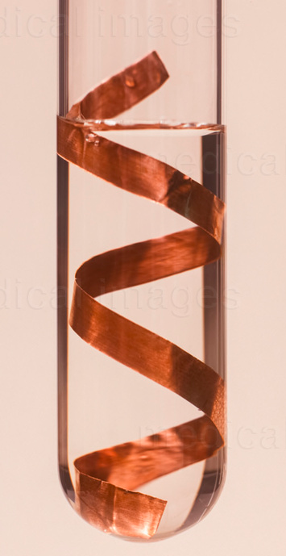
Metal displacement reaction
What if we put copper metal in zinc sulfate?
No reaction occurs, the copper does not transfer its electrons to zinc cations
Suggests there is a reactivity series – some things are more reactive than others
You would have seen this in Experiment 19 and 20
Copper
Cu_{(s)}
Zinc sulfate
Zn²⁺_{(aq)}

Slide 6
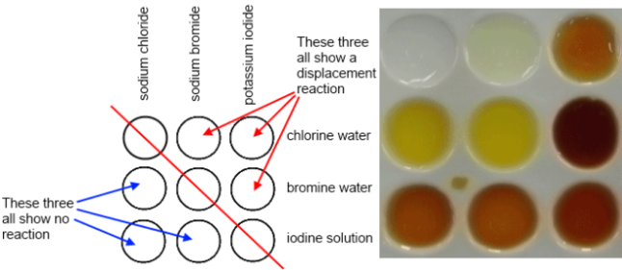
Spontaneous redox reactions
Spontaneous:
Zn(s) + Cu²⁺(aq) → Cu(s) + Zn²⁺(aq)
Spontaneous:
Cl₂(aq) + 2 Br⁻(aq) → Br₂(aq) + 2 Cl⁻(aq)
Cl₂(aq) + 2 I⁻(aq) → I₂(aq) + 2 Cl⁻(aq)
Br₂(aq) + 2 I⁻(aq) → I₂(aq) + 2 Br⁻(aq)
Not spontaneous:
Cu(s) + Zn²⁺⁽aq) → No reaction

Slide 7
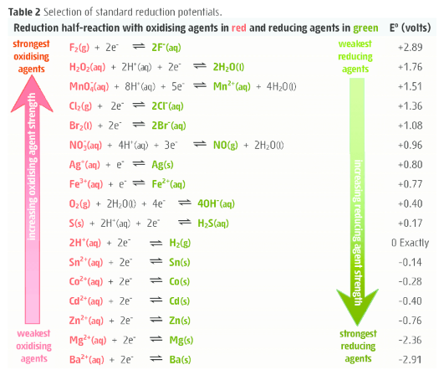
Standard Reduction Potential table
E⁰ is for the reaction as reductions
The more positive E⁰ the greater the tendency for the substance to be reduced
The more negative E⁰ the greater the tendency for the substance to be oxidized

Slide 8
SRP to predict outcomes
Under standard-state conditions, any species on the left of a given half-reaction will react spontaneously with a species that appears on the right of any half-reaction located below it in the table (the diagonal rule)
e.g. chlorine (Cl₂) will react with bromide (Br⁻)

Slide 9
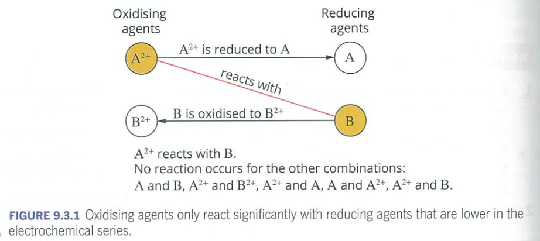
Rule of diagonals

Slide 10
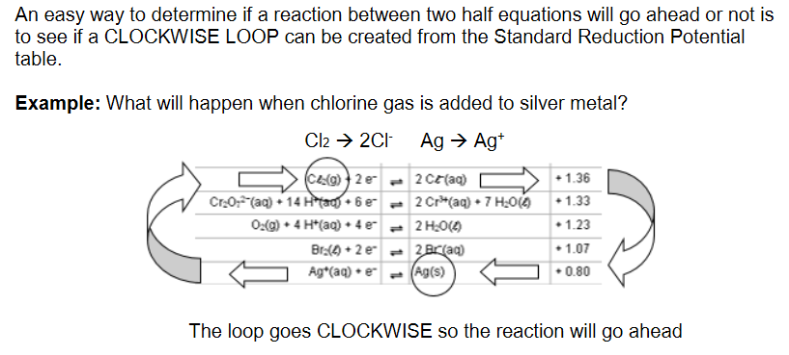
Rule of diagonals

Slide 11
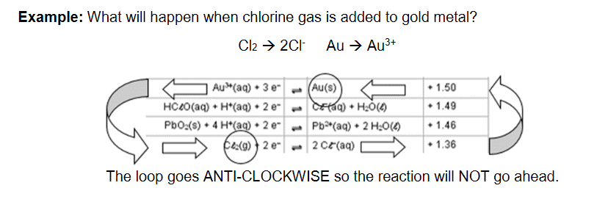
Rule of diagonals

Slide 12
Limitationd
The SRP table is based on standard conditions.
The half-cells potentials vary with temperature, pressure and concentration.
When the real world conditions are vastly different to the standard conditions, the order of the half-equations changes so predictions are no longer possible.
Finally, predictions only tell us if the reaction is spontaneous. It tells us nothing about the rate of reaction (how quickly it occurs)

Slide 13
On going work
Start working through the Redox booklet (the answers and an electronic copy of the booklet is on OneNote for you)

